Slide 1

ECO FRIENDLY PORTABLE COOLING SYSTEM
TEAM: TECHNOCRATS
PROJECT ID: 39
PROJECT MODEL DEVELOPED BY MEMBERS:
NIYATI SINHA (1805501)
AAKASH KUMAR DASH (1805452)
DEEPAK KUMAR YADAV (1805483)

Slide 2
DECLARATION
We here by declare that the details on the project entitled ' ECO FRIENDLY PORTABLE COOLING SYSTEM' submitted by us is our genuine work. And we declare that the work reported in this project has not been submitted and will not be submitted either in part or in full, by any other candidate in any exhibition.

Slide 3
ACKNOWLEDGEMENT
It is not possible to prepare a project without the assistance and encouragement of general folks, this one is certainly no exception.
We have immense pleasure in celebrating successful completion of our model entitled, 'ECO FRIENDLY PORTABLE COOLING SYSTEM'.
We extend our gratitude to KIIT UNIVERSITY for nurturing little skill seeds to excelling talents. The idea of our project was no less than a thought that came out in the scorching summers of our hostel life.
We are also thankful to our college library and administrative staff, who directly or indirectly made us progress.
We greatly appreciate the motivation and support of our parents, who encouraged us to extend our reach.

Slide 4
ABSTRACT
Our project aims to solve two of the major problems faced by general community, first is the lack of cheap and affordable air conditioning systems, and the other is of getting purified air.
The basic idea is based on the working of Thermoelectric coupler modules (TEC1-127xx) in which we use the physics of atoms, that an applied temperature gradient causes charge carriers in the material to diffuse from the hot side to the cold side which in turn produces a potential difference across the two sides and vice versa. This temperature difference is utilized to cool the environment.
The efficiency of our model was increased by minimizing the temperature of the hotter side, which was quite a challenging task, so we applied external eco-friendly cooling technique using water circulation through an earthen pot as well as, a normal fan in order to get the cooling system at the cheapest possible cost.

Slide 5
INTRODUCTION
During the hot summers, almost everyone turns to the cold comfort provided by air conditioning. But what many people don’t realize – or chose to overlook – is the environmental harm air conditioning brings with it. Stan Cox, author of Losing Our Cool: Uncomfortable Truths About Our Air-Conditioned World, told The Independent,
“Air conditioning’s environmental damage is not limited to emissions of greenhouse gases and ozone-depleting chemicals. Lavish deployment of indoor climate control may indeed make it possible for us to live anywhere on the planet, but is that wise?”
Eco-friendly air conditioning is becoming more widespread as air conditioner manufacturers phase out ozone-depleting refrigerants in their products in order to meet new government regulations.
A number of technological innovations are also making AC units greener. But still these technologies stand far away from the Indian middle class society. This was a realised by us while the scrotching summers in our hostel rooms, which led us to make an air-conditioner that can serve multiple-purposes like air-filteration, dryer, and can also provide extra socket points while using eco-friendly and replenishable sources like water, earthen pot 'matka' , camphor etc and is portable and much more cheap.

Slide 6
SOFTWARE AND COMPONENTS
SOFTWARE:
ARDUINO IDE
PROTEUS (SIMULATION SOFTWARE)
COMPONENTS:
THERMOELECTRIC COUPLER(TEC-12706)
BUCK CONVERTER(DC - DC)
WATER PUMP
FAN
SMPS
ARDUINO UNO R3
TEMPERATURE SENSOR(DHT 11)
LCD DISPLAY
EARTHEN POT

Slide 7
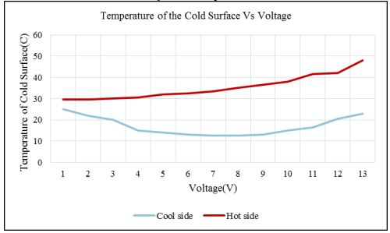
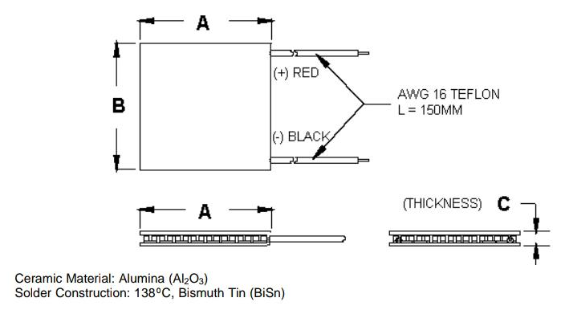
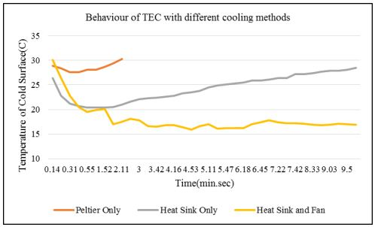
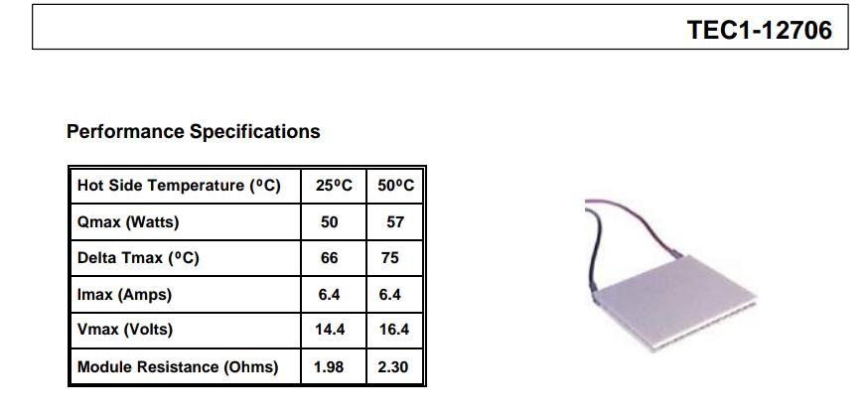

CHARACTERISTICS OF THERMOELECTRIC COUPLER
MAXIMUM OPERATING TEMPERATURE: 138°C
LIFE : 200,000 HOURS
SUCCESS RATE ON LONG TIME TESTING: 99.8%

Slide 8
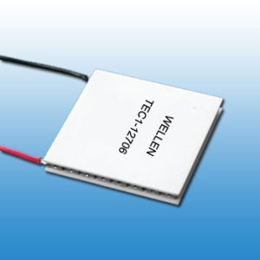
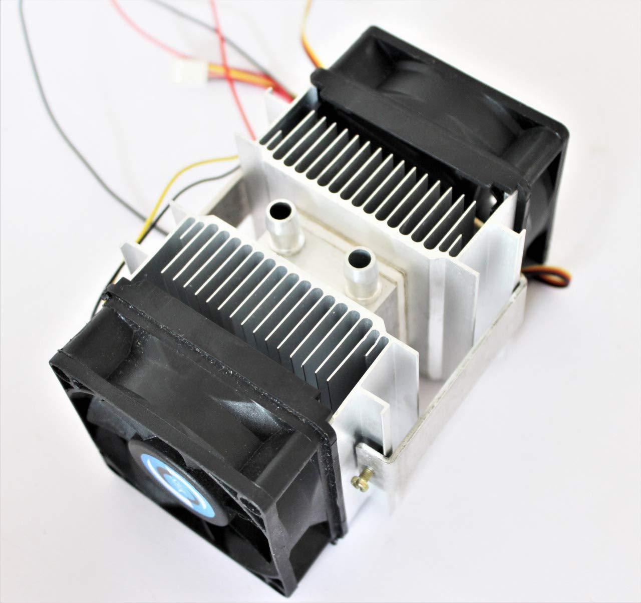
WORKING

Slide 9
DESIGN OF THE MODEL
AIR REGULATIONS
CAMPHOR WALL
OUTER-HEAT SINK
DISPLAY
T.S
THERMOCOL INSULATED WALLS
WATER REGULATION
HS2
OUT AIR FLOW
EARTHERN POT
FAN
TEC-12706
SMPS
BUCK CONVERTER

Slide 10
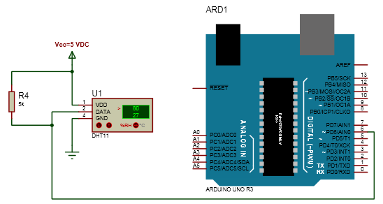

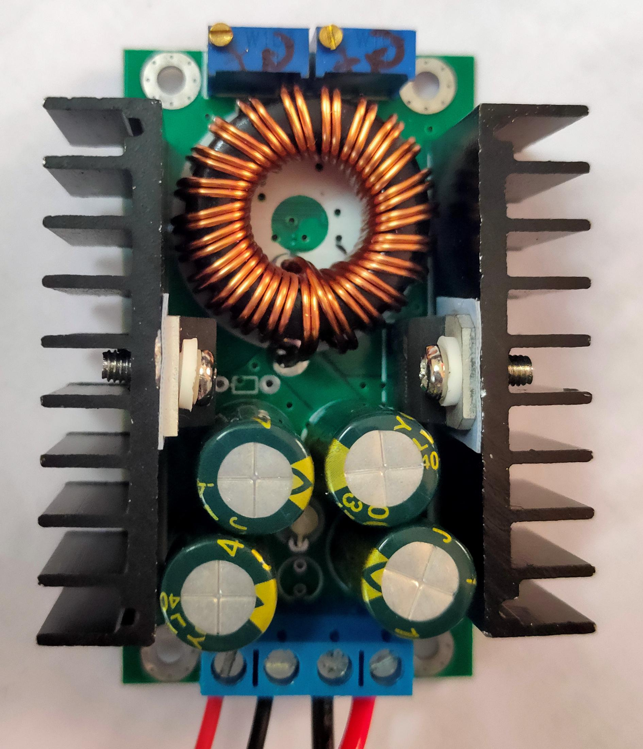
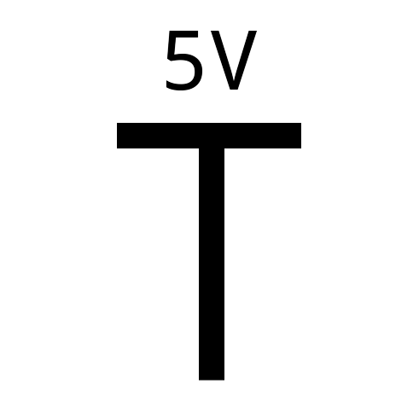
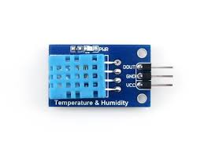
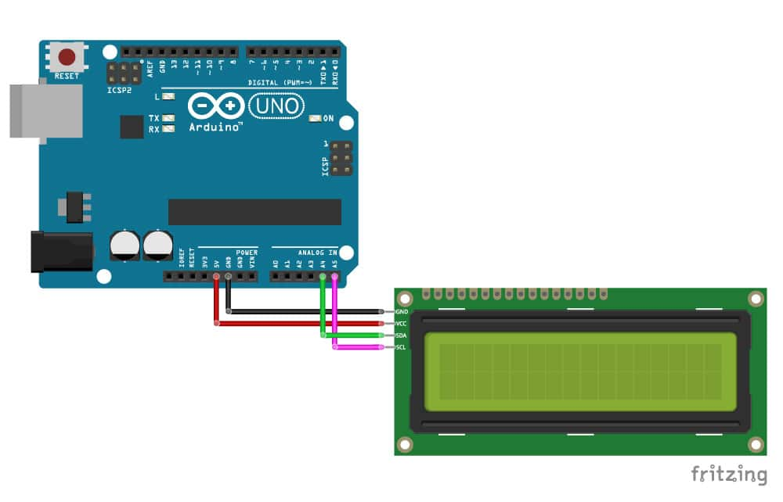

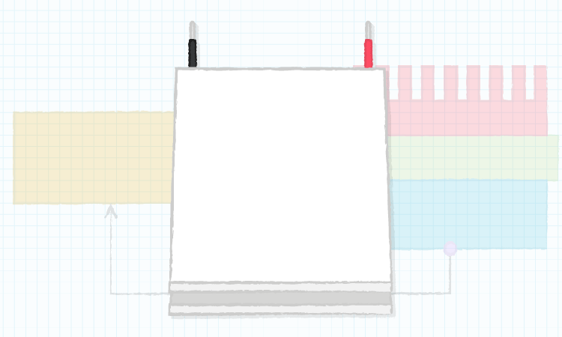

CIRCUIT DIAGRAMS
AC supply
SMPS
Buck Converter
Arduino UNO R3
DHT 11
(Temp. sensor)
LCD Display
TEC Module
TEC Module

Slide 11
ADVANTAGES
ECO-FRIENDLY
PORTABLE
SMALL SIZE
LIGHT WEIGHT
USES RENEWABLE ENERGY SOURCES MAINLY
PREVENTS GLOBAL WARMING

Slide 12
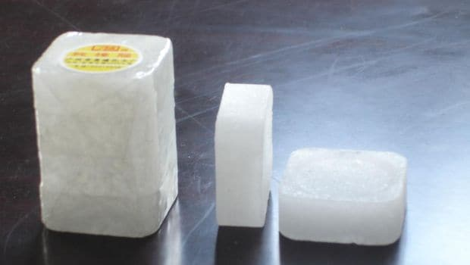
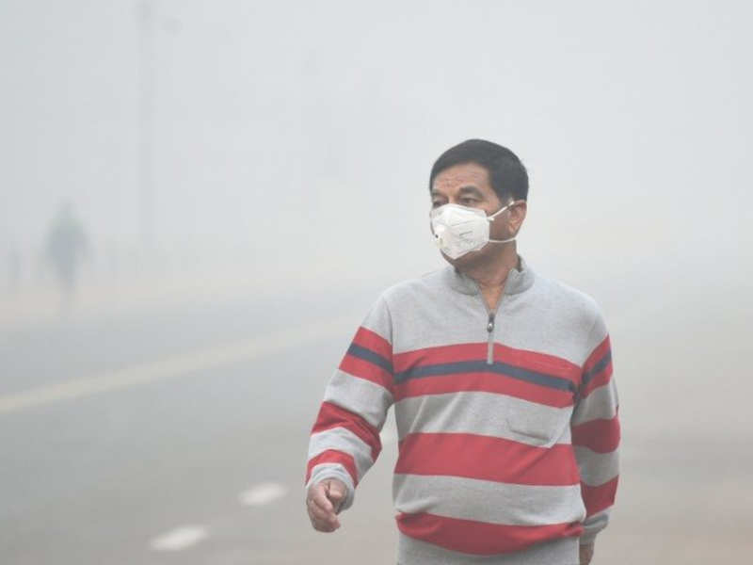
AIR PURIFICATION
PROPERTIES OF CAMPHOR
1. ANTI FUNGAL
2. ANTI BACTERIAL

Slide 13
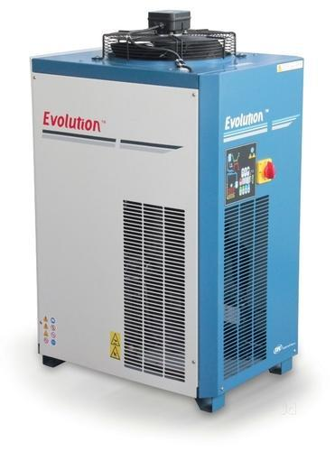

AIR DRYER

Slide 14


EXTERNAL SOCKET
15A
BUCK-CONVERTER
4A
2A
2A

Slide 15


PRICE EFFICIENT( ECONOMICAL )

Slide 16
COMPARISION
 | NORMAL AC+DRYER+AIR PURIFIER | ECO PORTABLE COOLING SYSTEM
PRICE | 50,000 approx | 5000-6000approx
WEIGHT | 13-15KG | 1KG
COMPLEXITY | HIGH | LOW
ENVIRONMENT EFFECTS | HAZARDOUS | ECO-FRIENDLY
FRAGILITY | HIGH | LOW
MAINTENANCE COST | HIGH | VERY LOW

Slide 17
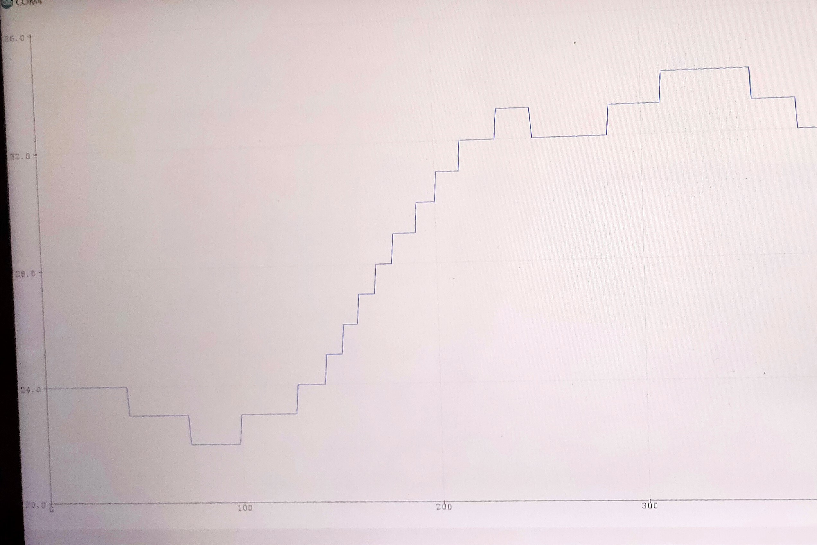
TESTING AND DATA ANALYSIS

Slide 18
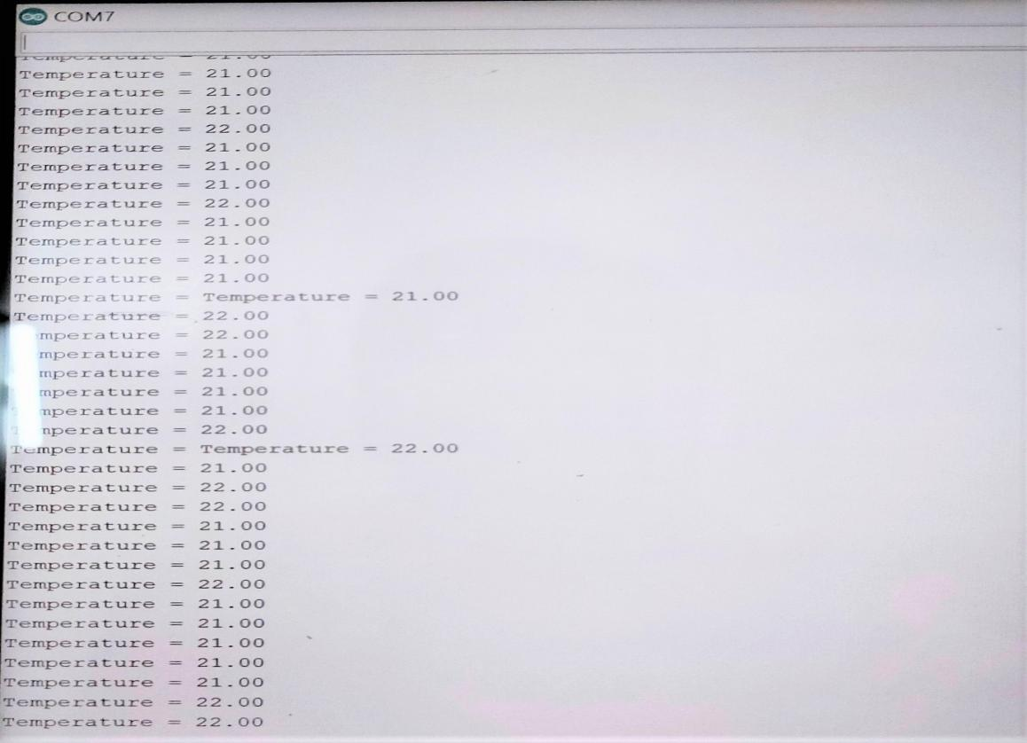
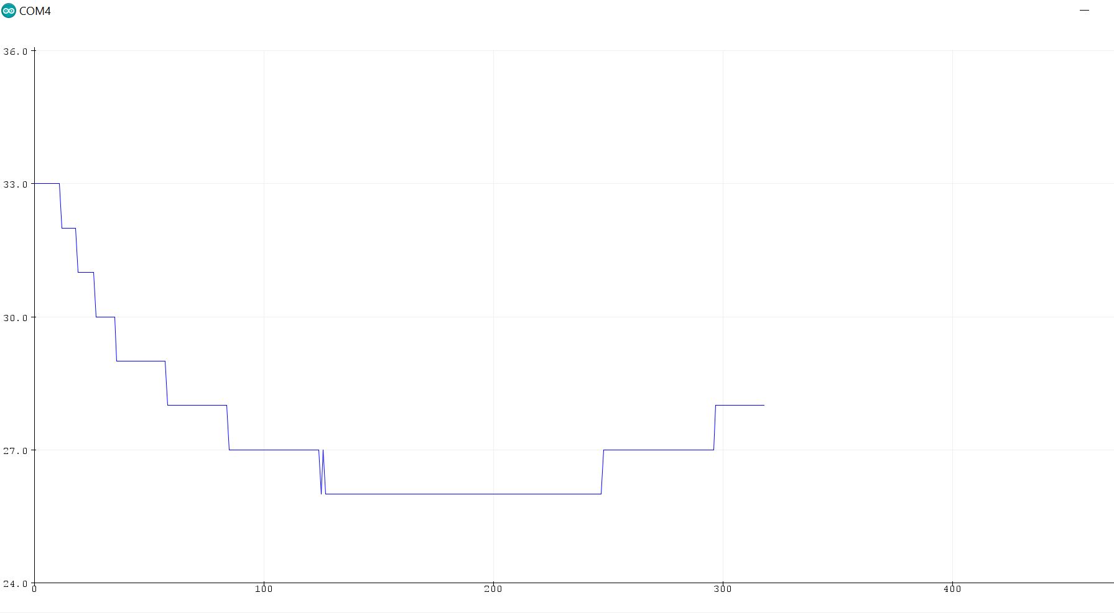
TESTING AND DATA ANALYSIS

Slide 19
RESULTS
We built a thermoelectric cooling system which is affordable, compact, portable, requires less maintenance, eco-friendly, easily repairable by a person from non-technical background.
It can be used by middle-class people for their personal comfort.
It also provides basic air purification and dryer facility.
The model can attain a temperature difference of roughly 12 °C, which is fairly good for a cooling system at this scale.
In tests, our model was able to reach a temperature of 21 °C inside the simulated room which was initially at 32 °C within 15 - 25 minutes. The temperature stabilizes after this.
It is highly economical.

Slide 20
LIMITATIONS
The best part about our project is that the pros are much more significant than the cons. Mentioned below are the limitations to our model:
SMALL SCALE
WATER AVAILABILITY

Slide 21
REFERENCES
1. ARDUINO.CC
2. PELTIER AND THOMSON EFFECT-AN OVERVIEW(SCIENCE DIRECT)
3. Camphor Effects-Indiatimes.com(Sushmita Mukherjee)
4. Losing Our Cool: Uncomfortable Truths About Our Air-Conditioned World (and Finding New Ways to Get Through the Summer) by Stan Cox (ISBN-13: 978-1595587756 , ISBN-10: 9781595587756)
5. Akram, Najath & Nirmani, H. & Jayasundere, Nisabha. (2016). A Study on Thermal and Electrical Characteristics of Thermoelectric Cooler TEC1-127 Series. 430-434. 10.1109/ISMS.2016.42.
6. Shyamu Gupta , Ankur Srivastav, Subhaan Allah, Gaurav Tiwari , , , , ."Thermoelectric Refrigeration System", Volume 6, Issue IX, International Journal for Research in Applied Science and Engineering Technology (IJRASET) Page No: 269-273, ISSN : 2321-9653, www.ijraset.com
7. Patil, R.H.. (2008). “Thermocol as thermal insulation: A key tool in implementation of energy conservation building code of India”. Journal of the Institution of Engineers (India): Architectural Engineering Division. 89. 26-30.
8. Zuccarini, Paolo & Soldani, Giulio. (2009). Camphor: Benefits and risks of a widely used natural product. Acta Biologica Szegediensis. 53. 77-82.
9. https://www.airsystems-inc.com/air-purification-news/air-quality/indoor-air-quality-and-camphor-production/
10. https://www.marlow.com/how-do-thermoelectric-coolers-tecs-work
11. https://en.wikipedia.org/wiki/Thermoelectric_cooling#Identification_and_characteristics
12. https://en.wikipedia.org/wiki/Thermoelectric_cooling

Slide 22
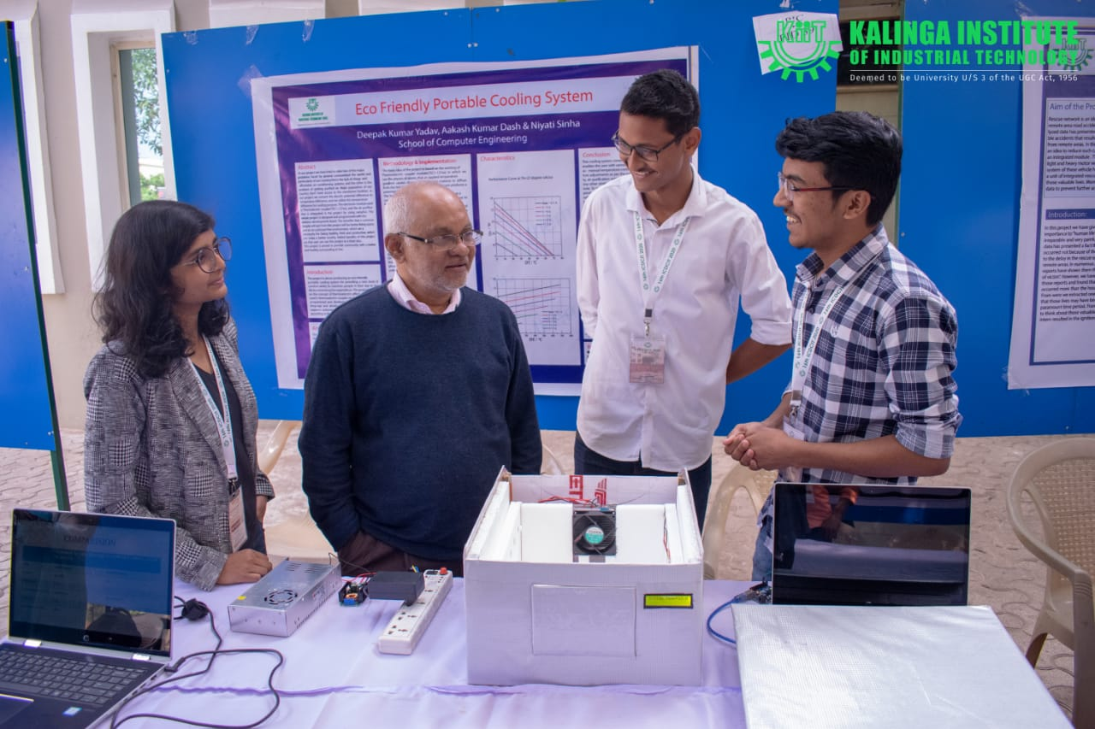
ACHIEVEMENTS
WON THE FIRST PRIZE IN TECHNOVISION 2019
WON THE SECOND PRIZE IN PIC 2020 - ICDCIT
GOT PUBLISHED IN PROJECT INNOVATIONS IN DISTRIBUTED COMPUTING AND INTERNET TECHNOLOGY with ISBN: 978-93-5391-188-1

Slide 23
THANK YOU

